Slide 1
Finance Credit Team Sprint Update 4
October 30th, 2023
Lucas | Kendall | lakendal@mtu.edu
Trent | Magers | tfmagers@mtu.edu
Emily | Wood | Ewood@mtu.edu
Reyn | White | walterw@mtu.edu
Irene | Trierweiler | Iltrierw@mtu.edu
Joseph | Williams | jokwilli@mtu.edu
Atharva | Joshi | atharvaj@mtu.edu
John | Mware | jmware@mtu.edu

Slide 2
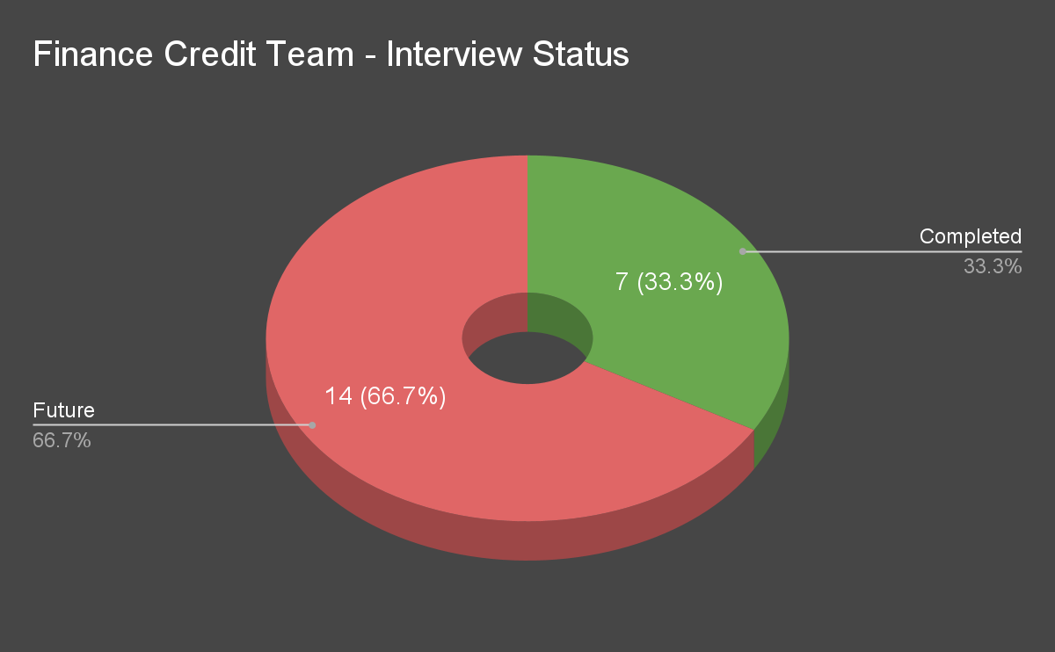
Interviews Status

Slide 3
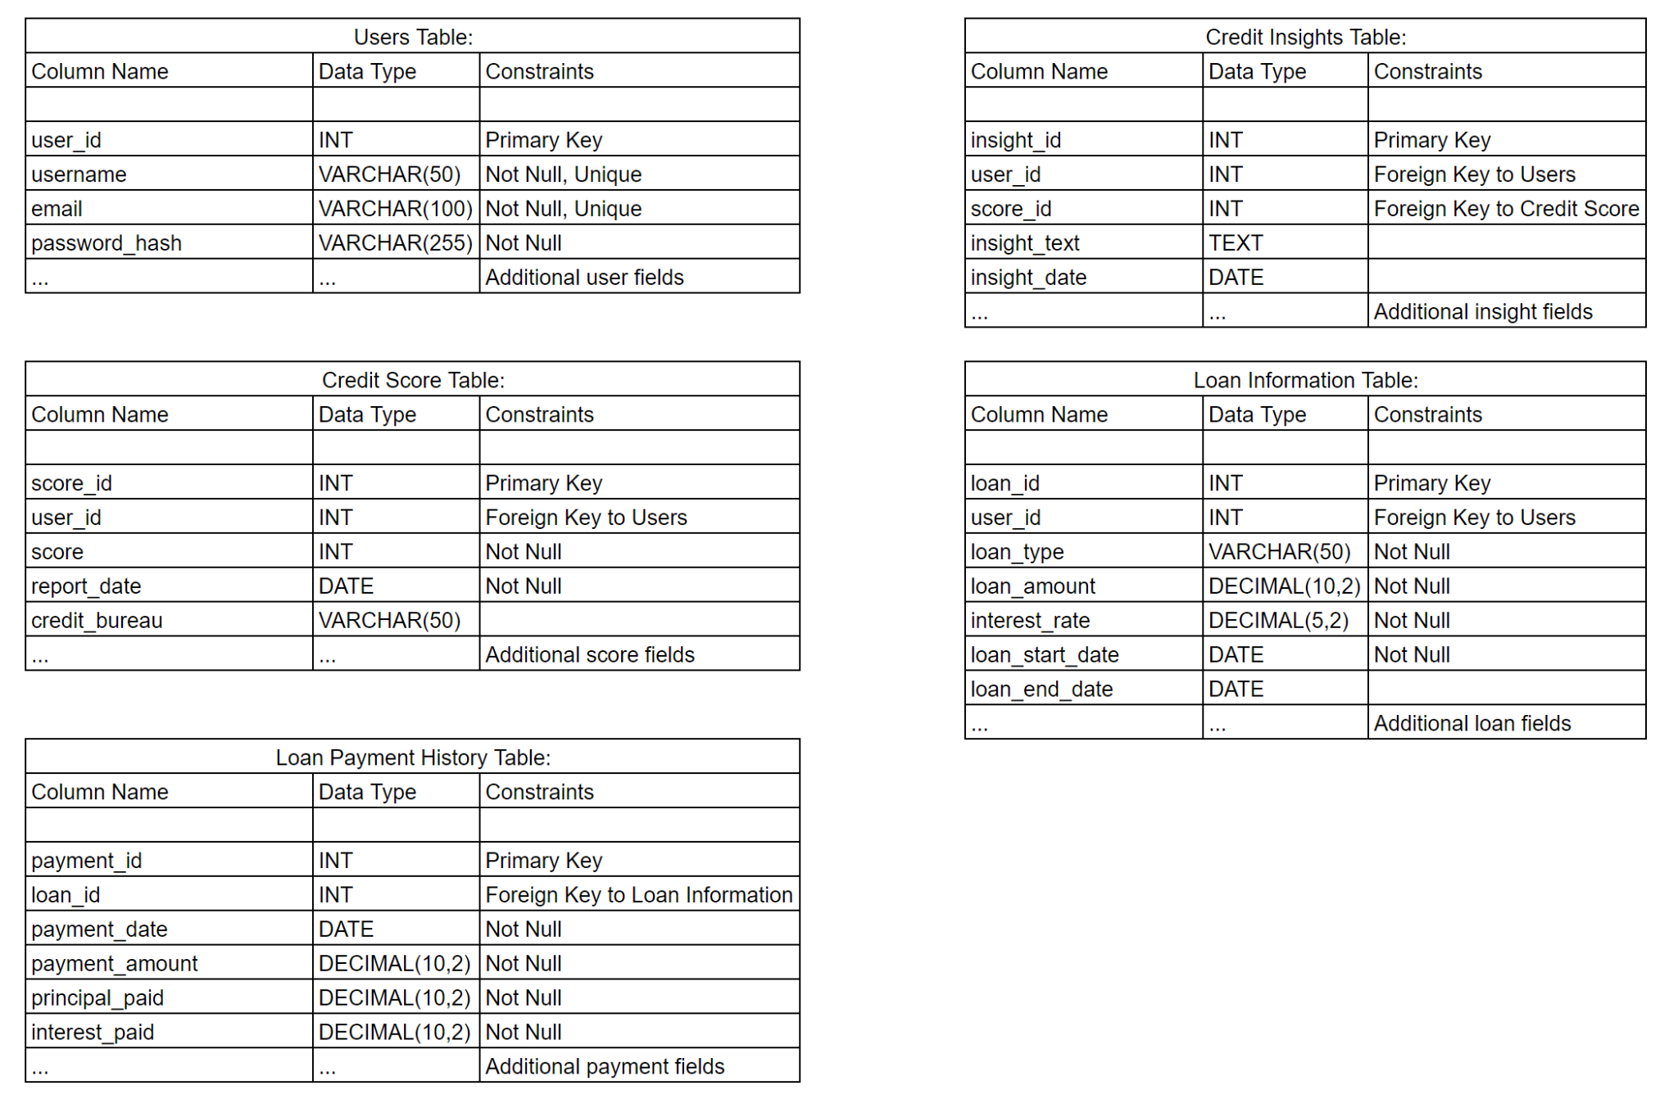
Database Schema

Slide 4
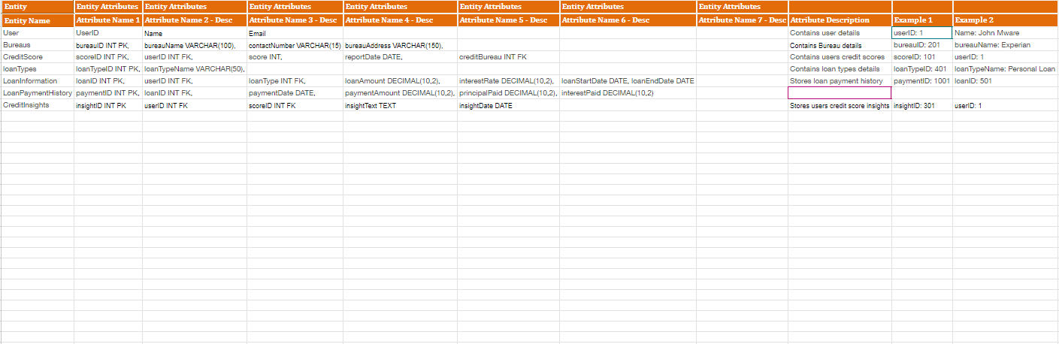
TSD Document - Specifications

Slide 5
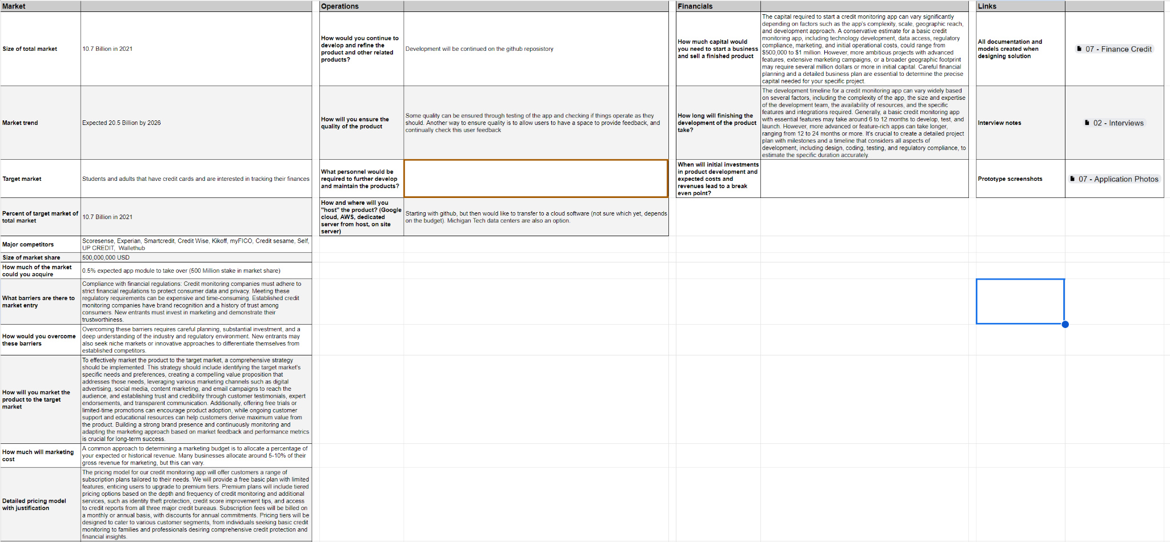
Business Portfolio - Questions

Slide 6

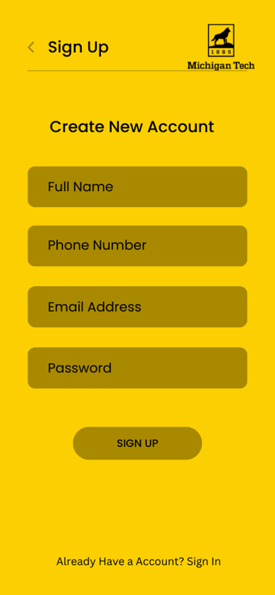
Application Development - Front End

Slide 7
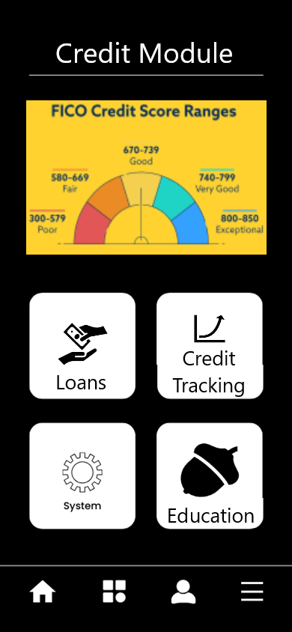
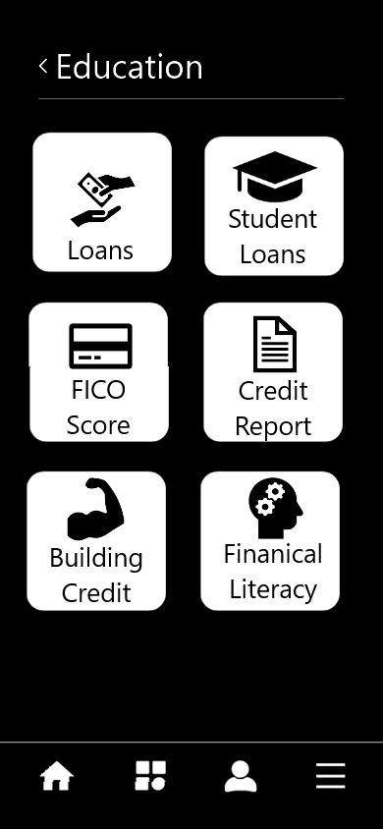

Application Development - Front End

Slide 8
Steps Moving Forward
Interviews
Driving additional 4 interviews with new questions
Remaining 8 interviews for future development/feedback.
Front End Cross Development
Application web based development.
Business Case Development
Submitted Business Case Questions.
Continuous Improvement on Trello project tracking.

